Slide 1
Live Session 03: End User Web Pages
DB Structure for End User

Slide 2
Develop the Web Pages in
Angular for End User Web App

Slide 3


Before we begin, lets recall what we have covered till now:
Angular
Cucumber

Slide 4
Project Planning with Agile
Developed User Stories under the Epic Admin and End User
Managed project using JIRA by planning the Sprints
Develop Angular Project Structures
Created project structure for Admin and end users
Explored Angular CLI commands
Generated components and services for projects
Sync the Projects with Git on Github
Pushed the Angular Projects on github

Slide 5
As a full stack web developer, our key role is to develop both client and server software.
Angular and Node can be used to build front end of the web page.
Spring Boot, Java, and MySQL/MongoDB can be used to build at the back end.

Slide 6


A Day in the Life of a Full Stack Developer
Now, Bob needs to create a web page and DB for the end-user web wpp to further proceed with his project.
Let me use previously used technologies to created web page and DB for End user Web App.
In this lesson, we will learn the skills of HTML and CSS to design and develop web pages in previously created Angular Project and User SQL Commands to create tables in DB for End-User Web App and help Bob complete his task effectively and quickly.

Slide 7

Develop the web page templates for end-user web app
Develop the CSS for styling the web pages and configure routing
Use SQL commands create tables for end-user web app
Create primary and foreign key relations within tables

Slide 8
Angular Component Templates for End User
Notes:
Web App for End User is the next module In this project.
Here we will maintain and manage various modules eg listing the products for end-user, managing cart, managing wishlist and orders placed by them, etc.
Let us develop the web page templates for basic operations using HTML and CSS for our previously created components in the End User Angular Project

Slide 9
Web App for End User
In this project, various modules will be managed, such as:
Listing the products for end-user
Managing cart
Managing wishlist and orders
Notes:
Web App for End User is the next module In this project.
Here we will maintain and manage various modules eg listing the products for end-user, managing cart, managing wishlist and orders placed by them, etc.
Let us develop the web page templates for basic operations using HTML and CSS for our previously created components in the End User Angular Project

Slide 10
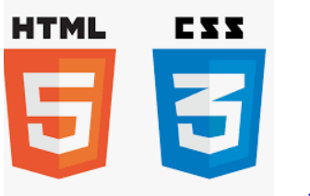
Web App for End User
For basic operations, the web page templates are developed using:
Notes:
Web App for End User is the next module In this project.
Here we will maintain and manage various modules eg listing the products for end-user, managing cart, managing wishlist and orders placed by them, etc.
Let us develop the web page templates for basic operations using HTML and CSS for our previously created components in the End User Angular Project

Slide 11
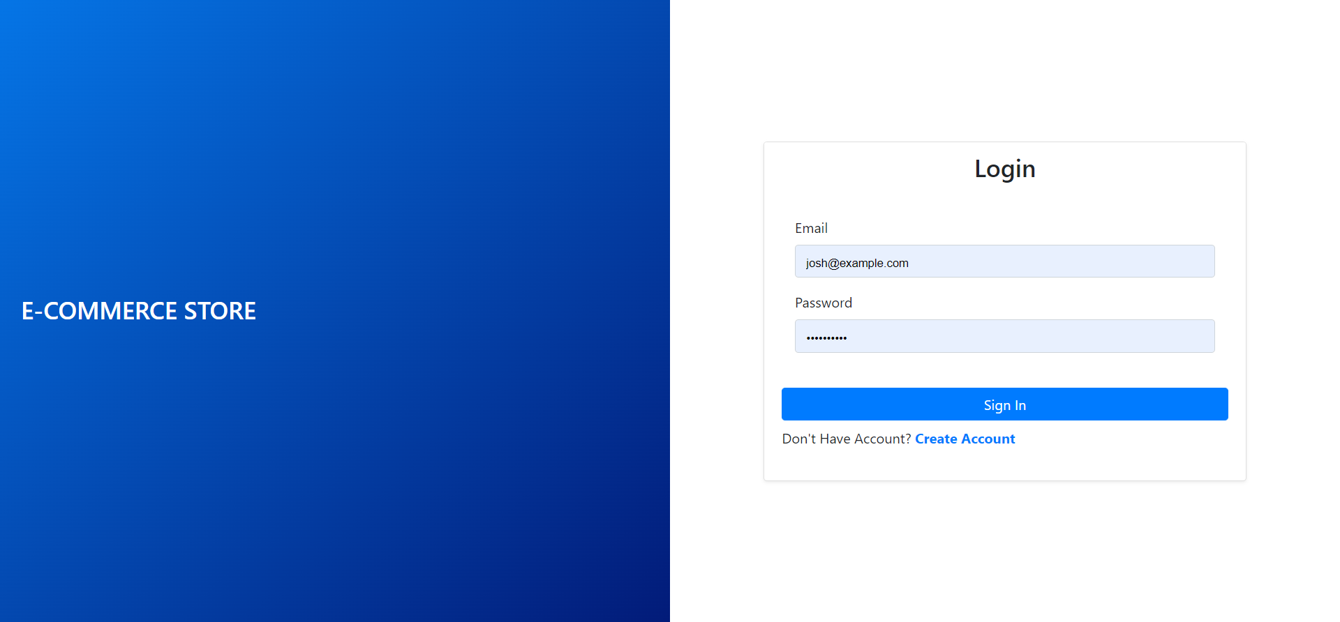
Web Page for Authentication Login Component
Develop a login page for end user to sign in and enter into the home page.
Login page
Notes:
We will develop a login page for end user to sign in and enter into the home page.

Slide 12
Web Page for Authentication Login Component
Design the login page with an email, a password, and a login button.
Notes:
In our generated component authentication we will design the login page which will have the email, password and a login button.

Slide 13
Web Page for Authentication Login Component
Click on the login button, validate the user, and navigate to the home page which will have a navigation bar with various options.
Notes:
On click of login button, we will validate the user and navigate to the Home Page which will have a navigation bar with various options.

Slide 14

Web Page for Authentication Login Component
Various files from the given directory: src/app/pages/login/
login.component.css
CSS goes here to design the page and forms.
login.component.html
HTML code is written in this template file.
login.component.ts
Logic will be written in typescript file.
Notes:
In the directory: src/app/pages/login/
login.component.css : CSS goes here to design the page and forms
login.component.html : HTML Code is written in this template file
login.component.ts: Logic will be written in typescript file
Image id: 1384

Slide 15
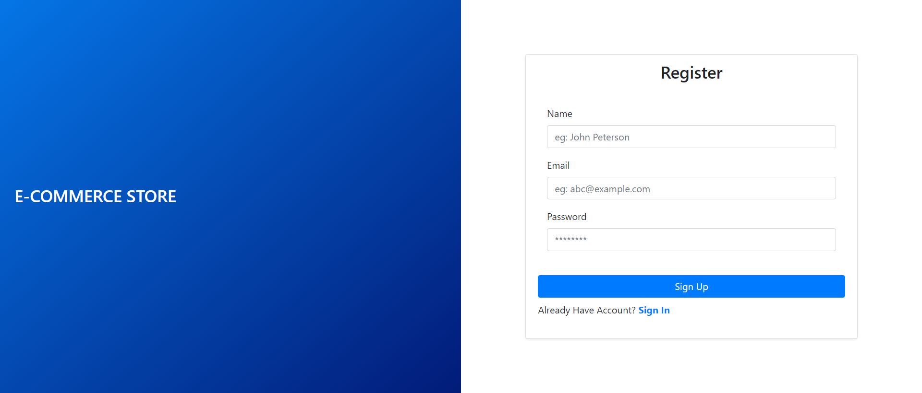
Web Page for User Registration Component
A new user needs to register.
Notes:
A new user needs to register

Slide 16
Web Page for User Registration Component
Design a register component that can take Name, Email, and Password as input to register the user on the estore web app.
Notes:
And for the same in register component we will design the web page which can take name email and password as input to register the User on the estore web app

Slide 17
Web Page for User Registration Component
After registration, navigate to the home page, which will have a navigation bar with various options.
Notes:
and navigate to the Home Page which will have a navigation bar with various options.

Slide 18

Web Page for User Registration Component
In the directory: src/app/pages/register/
register.component.css
CSS goes here to design the page and forms.
register.component.html
HTML code is written in this template file.
register.component.ts
Logic will be written in typescript file.
Notes:
In the directory: src/app/pages/register/
register.component.css : CSS goes here to design the page and forms
register.component.html : HTML Code is written in this template file
register.component.ts : Logic will be written in typescript file
Image id : 1303

Slide 19
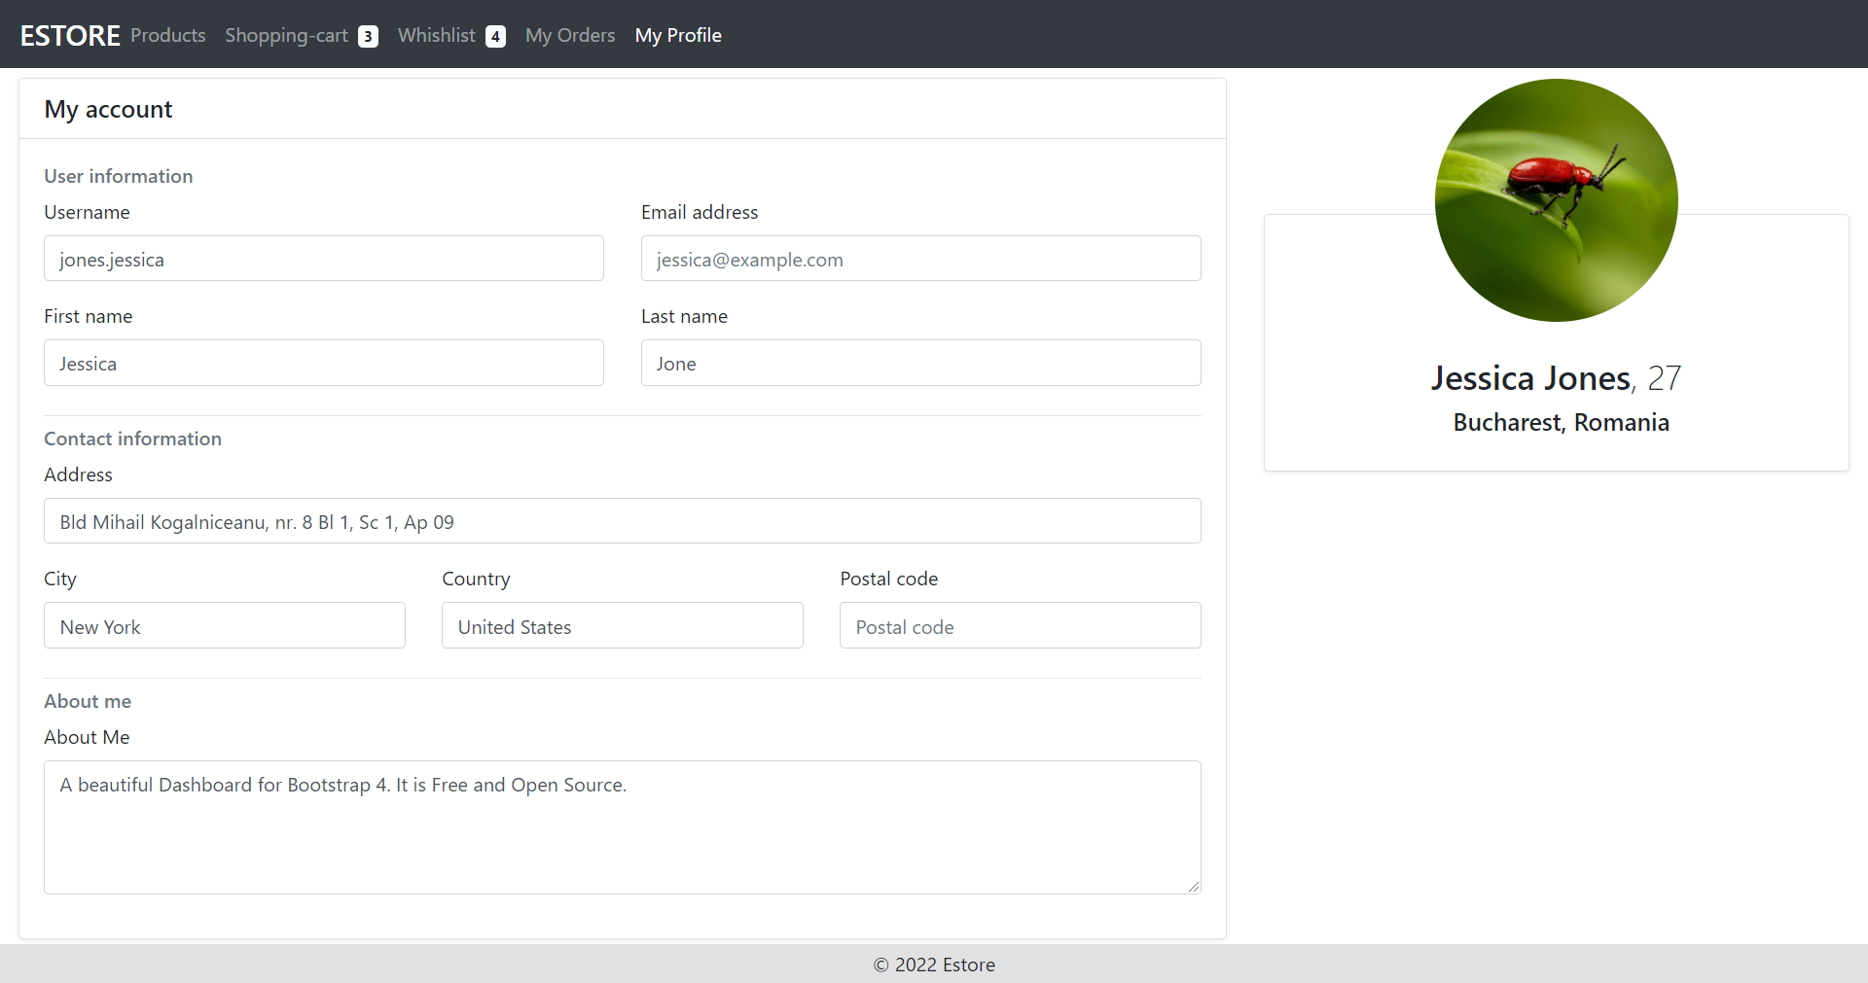
Web Page for Profile Component
Users can manage their profile by navigating to the profile component on the navigation bar.
Notes:
A user can manage his profile by navigating to the profile component on navigation bar.

Slide 20
Web Page for Profile Component
The web page will have details of the users who can manage their contact information, that is, the address for delivering the order.
Notes:
The web page will have details of the User. Alongwith details, user can manage contact information which is address for delivering the order to the User.

Slide 21

Web Page for Profile Component
In the directory: src/app/pages/user-profile/
user-profile.component.css
CSS goes here to design the page and forms.
user-profile.component.html
HTML code is written in this template file.
user-profile.component.ts
Logic will be written in typescript file.
Notes:
In the directory: src/app/pages/user-profile/
user-profile.component.css : CSS goes here to design the page and forms
user-profile.component.html : HTML Code is written in this template file
user-profile.component.ts: Logic will be written in typescript file
Image id : 3589

Slide 22
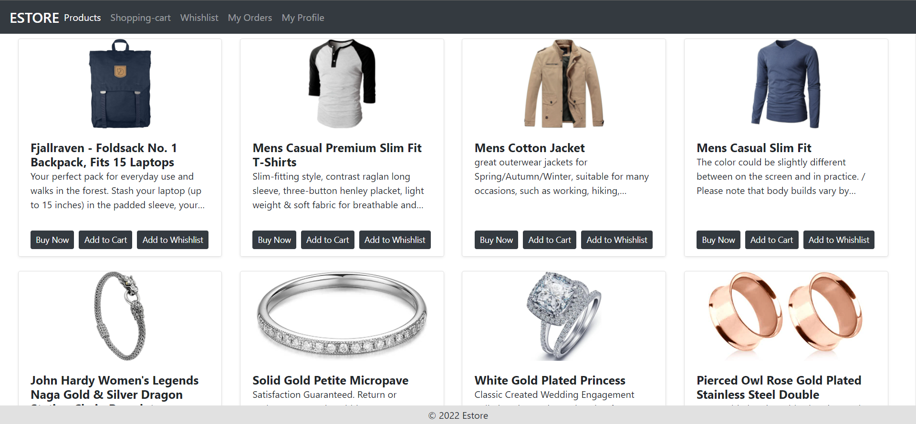
Web Page for Products Component
UI is developed to show the various products added by the admin.
Notes:
This is the main web page and we will develop the UI to show the various Products which are added by the admin.

Slide 23
Web Page for Products Component
All the products are listed along with the options to buy the product, add to cart, or add to wishlist.
Notes:
We will list all the products along with the options to buy the product, add to cart or add to the wishlist.

Slide 24
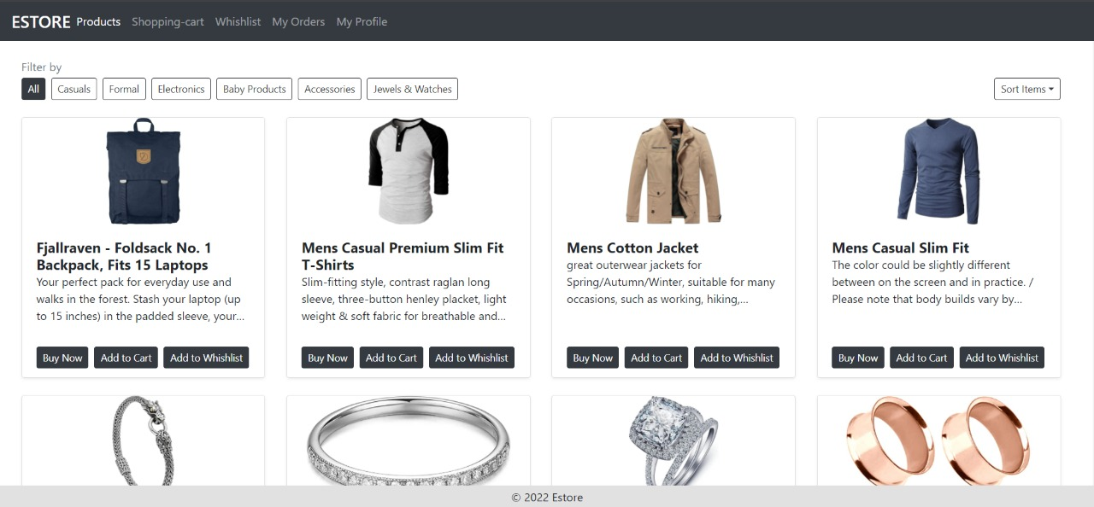
Web Page for Products Component
Search, sort, and filter operations can also be implemented on the same web page.
Notes:
You can implement the search sort and filter operations on the same web page as well, which we will introduce the same in our future algorithmic part once we communicate with the database

Slide 25

Web Page for Products Component
In the directory: src/app/pages/products/
products.component.css
CSS goes here to design the page and forms.
products.component.html
HTML code is written in this template file.
products.component.ts
Logic will be written in typescript file.
Notes:
In the directory: src/app/pages/products/
products.component.css : CSS goes here to design the page and forms
products.component.html : HTML Code is written in this template file
products.component.ts: Logic will be written in typescript file
Image id : 2673

Slide 26
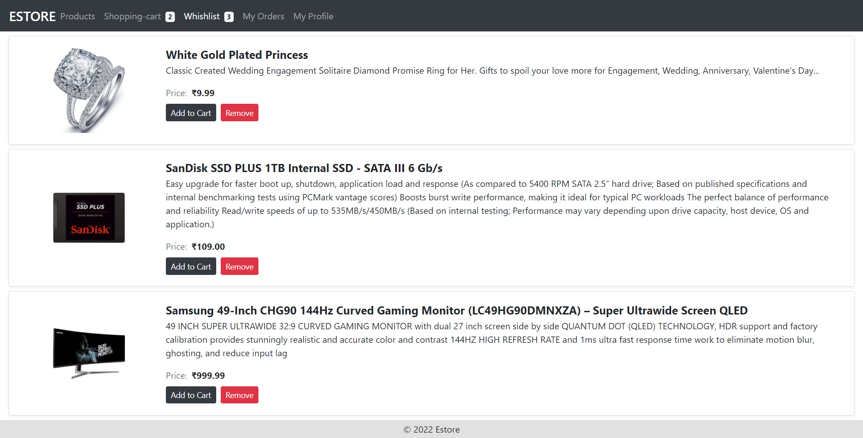
Web Page for Wishlist Component
Users can mark any product as the favourite by moving it to the wishlist.
Notes:
A user can mark any product as favourite by moving it to the wishlist.

Slide 27
Web Page for Wishlist Component
The Wishlist component shows the list of products that a user may buy in future.
Notes:
A wish list component shows the list of products which a user may buy in future.

Slide 28
Web Page for Wishlist Component
There is a button to move the product to the cart by clicking on Add to Cart near the product.
Notes:
We will have a button to move the product to cart by clicking the same appearing on the Product Item.

Slide 29

Web Page for Wishlist Component
In the directory: src/app/pages/wishlist/
wishlist.component.css
CSS goes here to design the page and forms.
wishlist.component.html
HTML code is written in this template file.
wishlist.component.ts
Logic will be written in typescript file.
Notes:
In the directory: src/app/pages/wishlist/
wishlist.component.css : CSS goes here to design the page and forms
wishlist.component.html : HTML Code is written in this template file
wishlist.component.ts: Logic will be written in typescript file
Image id : 3854

Slide 30
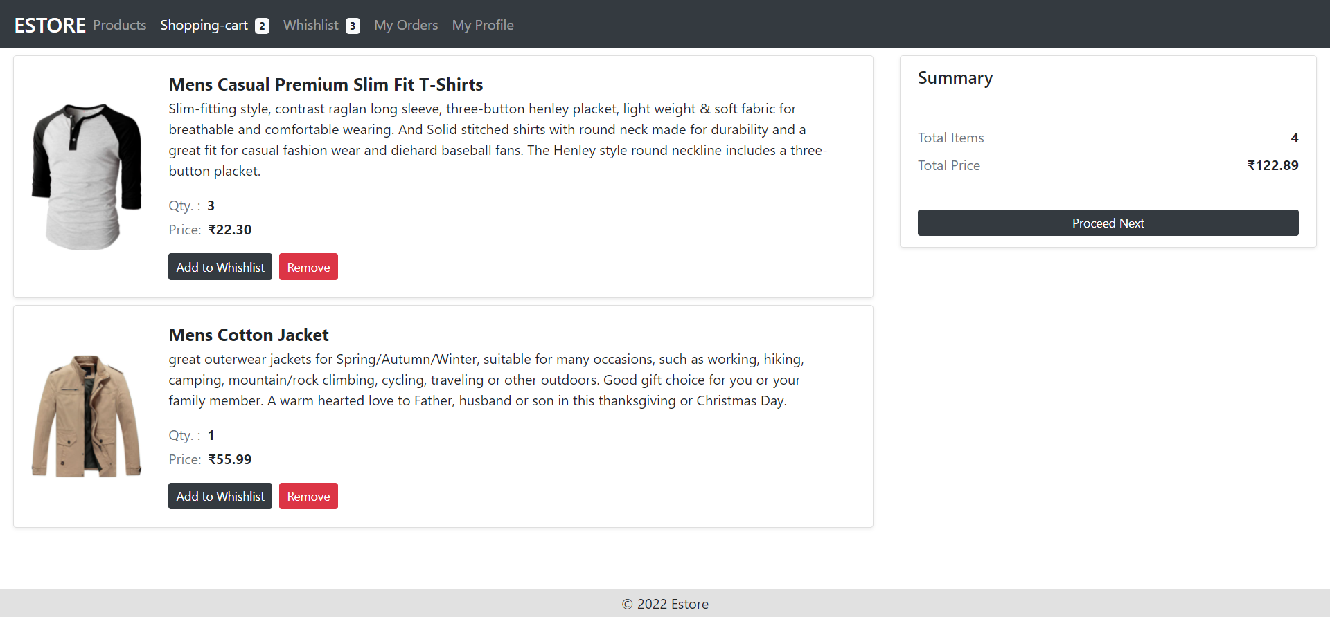
Web Page for Cart Component
The navigation bar is used to navigate to the cart tab where a user can see a list of the products along with quantity and price for the product.
Notes:
From the navigation bar user can navigate to Cart Tab where user will see list of the products along with quantity and price for the product.

Slide 31
Web Page for Cart Component
Summary of the products in order to be placed shall be shown along with the option to buy i.e. to place an order.
Notes:
Summary of the products in order to be placed shall be shown along with option to Buy i.e. to place an order.

Slide 32

Web Page for Cart Component
Payment's method page can also be implemented.
Notes:
We will implement navigation to the payments method page as in we advance in our DB Communication part.
Image id : 2615

Slide 33

Web Page for Cart Component
In the directory: src/app/pages/shopping-cart/
shopping-cart.component.css
CSS goes here to design the page and forms.
shopping-cart.component.html
HTML code is written in this template file.
Shopping-cart.component.ts
Logic will be written in typescript file.
Notes:
In the directory: src/app/pages/shopping-cart/
shopping-cart.component.css : CSS goes here to design the page and forms
shopping-cart.component.html : HTML Code is written in this template file
shopping-cart.component.ts: Logic will be written in typescript file
Image id : 1437

Slide 34
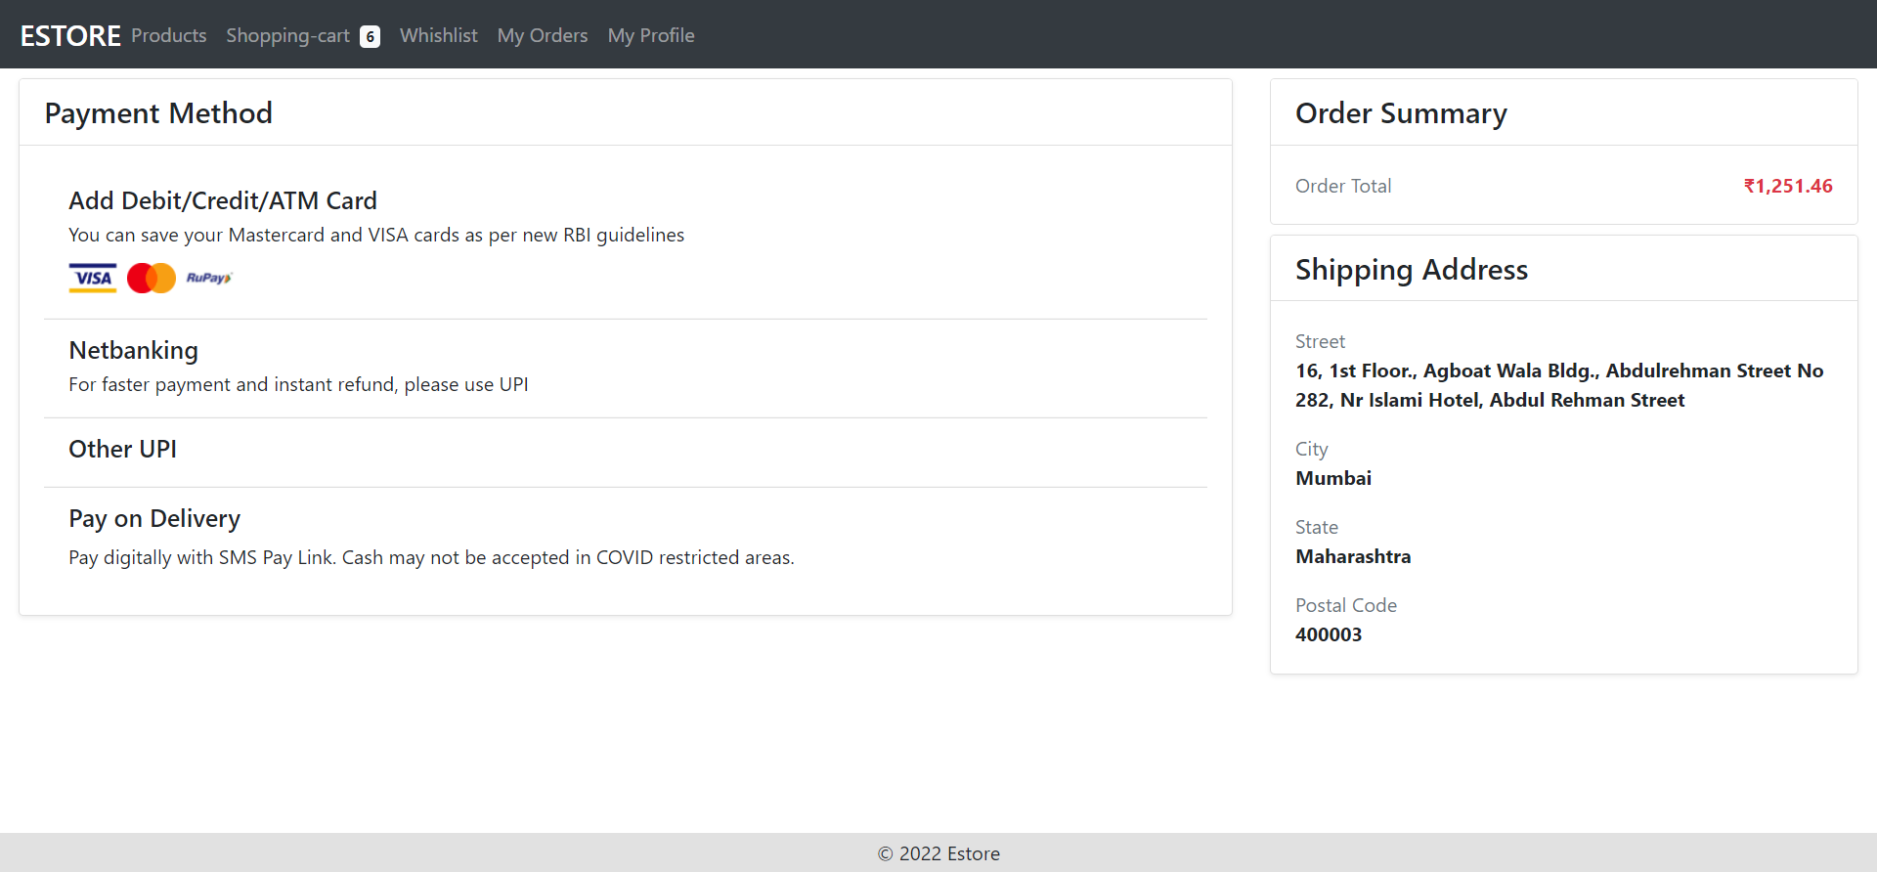
Web Page for Checkout Component
From the cart, users will be navigated to the final checkout page.
Place order
Notes:
From the Cart, user will be navigate to the final checkout page.

Slide 35
Web Page for Checkout Component
Users must choose the payment method and address for confirmation.
Place order
Notes:
User will choose the payment method and will be shown the address for the confirmation.

Slide 36
Web Page for Checkout Component
Finally, users must click on the place order button, and a successful order creation message will be shown.
Place order
Notes:
Finally user can click on the Place Order Button and a Successful Order Creation Message will be shown to the User.

Slide 37

Web Page for Checkout Component
In the directory: src/app/pages/checkout/
checkout.component.css
CSS goes here to design the page and forms.
checkout.component.html
HTML code is written in this template file.
checkout.component.ts
Logic will be written in typescript file.
Notes:
In the directory: src/app/pages/checkout/
checkout.component.css : CSS goes here to design the page and forms
checkout.component.html : HTML Code is written in this template file
checkout.component.ts: Logic will be written in typescript file

Slide 38
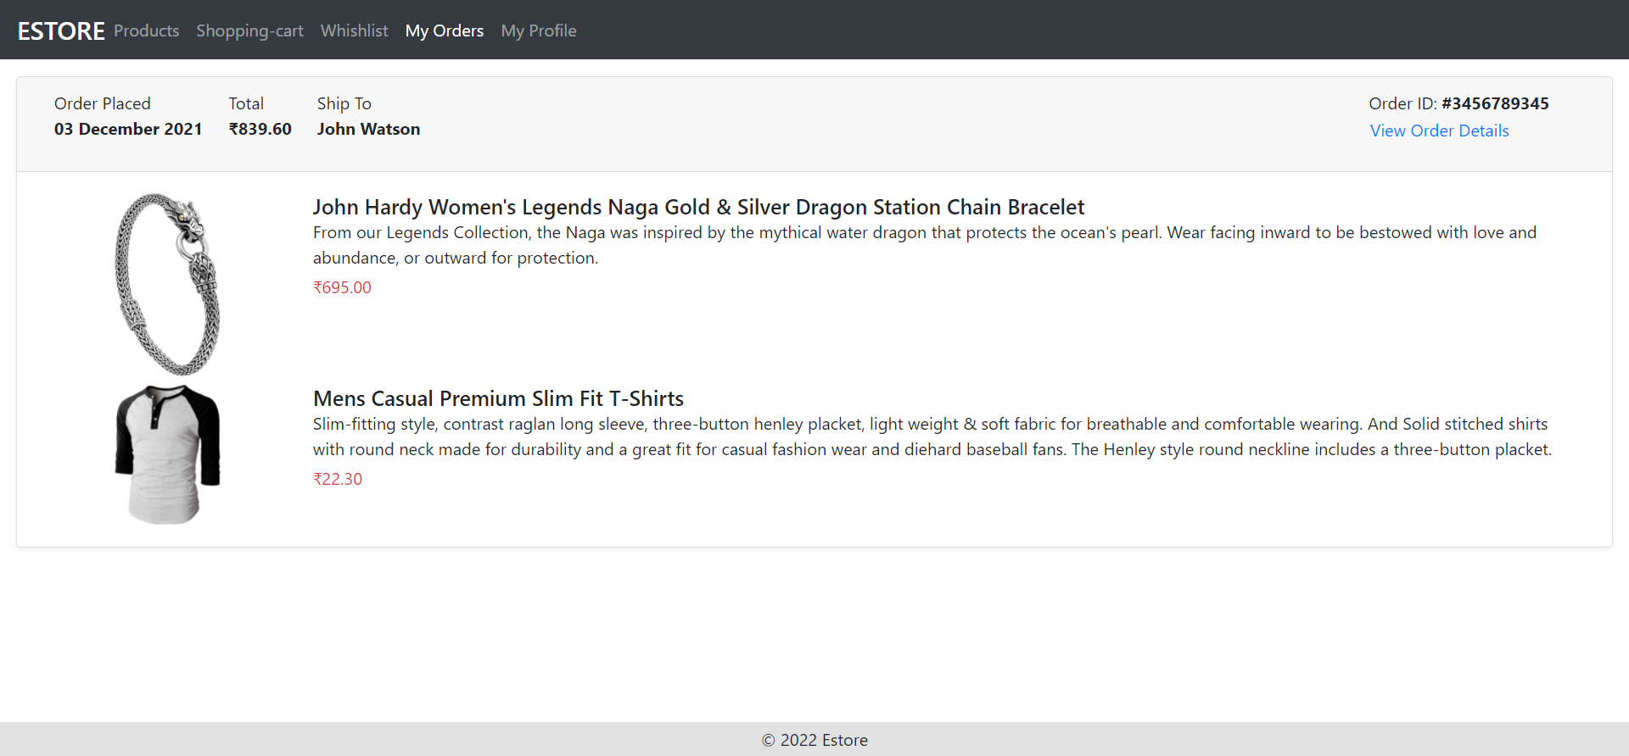
Web Page for Orders Component : View Orders
As the User will place an order from the account, the list of orders, along with the order status, will be displayed to the users for reference.
Notes:
As User will place order from account, the list of orders will be displayed to the User for reference purpose. Order will have State eg: Placed, Cancelled etc.

Slide 39
Web Page for Orders Component : View Orders
The detailed model can be opened on click of view order details in future as in when connected to the backend.
Notes:
A detailed model can be opened on click of View Order Details in future as in when we connect to the backend.

Slide 40
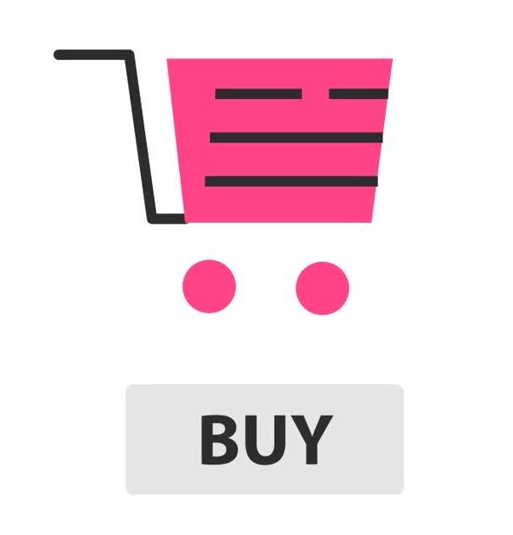
Web Page for Orders Component : View Orders
In the directory: src/app/pages/orders/
order.component.css
CSS goes here to design the page and forms.
order.component.html
HTML code is written in this template file.
order.component.ts
Logic will be written in typescript file.
Notes:
In the directory: src/app/pages/orders/
orders.component.css : CSS goes here to design thepage and forms
orders.component.html : HTML Code is written in this template file
orders.component.ts: Logic will be written in typescript file

Slide 41
DB Structure for End User

Slide 42
Creating Database

Slide 43

Creating DataBase in MySQL
MySQL CLI usage to create and work with the database.
Use database ecommerce
Selects current working database
02
Create database ecommerce
Creates the database for ecommerce
Show tables
Lists all the tables in the database
01
03
Notes:
We have already seen MySQL CLI usage to create and work with database
A quick Overview once again:
create database ecommerce;
This command was used to create the database ecommerce
use database ecommerce;
Execute this command for current working selection of the database to ecommerce
show tables;
This command will list all the tables in the database. As of now tables created for the admin dashboard will be listed.
Image id : 4771

Slide 44
Creating Tables
Notes:
Since we have created a database ecommerce, now we will create the tables in our recently created database for our End User Web App.
Many tables are common for the usage. eg: Order Table in Admin will be used by the Web App for End User as well. So we will be creating only the tables required for Cart, and the Wishlist. Rest all are already created during the Admin Table Structure

Slide 45

Creating Table
Many tables are common for usage. Example: the Order Table in Admin will be used by the Web App for the End User as well.
So, tables required for the cart and the wishlist will only be created.
Rest all tables are already created during the Admin Table Structure.
Notes:
Since we have created a database ecommerce, now we will create the tables in our recently created database for our End User Web App.
Many tables are common for the usage. eg: Order Table in Admin will be used by the Web App for End User as well. So we will be creating only the tables required for Cart, and the Wishlist. Rest all are already created during the Admin Table Structure.

Slide 46
Generating User Table for Login
Make sure the Database is selected as e-commerce or execute the command to make the DB selection for e-commerce as:
Use database ecommerce:
CREATE TABLE USERS(
userId INTEGER NOT NULL PRIMARY KEY AUTO_INCREMENT,
email VARCHAR(50) NOT NULL,
password VARCHAR(50) NOT NULL,
fullName VARCHAR(255) NOT NULL,
street VARCHAR(50) DEFAULT NULL,
city VARCHAR(50) DEFAULT NULL,
state VARCHAR(50) DEFAULT NULL,
country VARCHAR(50) DEFAULT NULL,
pincode INTEGER,
image VARCHAR(1000),
contact BIGINT,
addedOn DATETIME DEFAULT CURRENT_TIMESTAMP
);
) NOT NULL,
Notes:
The table User has already been created during the Admin Dashboard. So here we need not to create it again. This is for reference purpose of what we have already in the database for the User Authentication.

Slide 47
Generating User Table for Login
For simplicity, one address per user is considered.
In case a user has many addresses, an address table is created separately with a primary and foreign key relationship.
Notes:
For the simplicity, we are considering 1 Address per 1 User. Hence address structure is a part of User Table. In Case, 1 User has Many Addresses,
You need to create Address Table separately and have primary and foreign key relationship.

Slide 48
Generating Wishlist Table
Make sure the database is selected as ecommerce, or you can execute the command to make the db selection for ecommerce as :
Use database ecommerce:
CREATE TABLE WISHLIST {
wishListId INTEGER NOT NULL PRIMARY KEY AUTO_INCREMENT,
productId INTEGER NOT NULL,
userId INTEGER NOT NULL,
FOREIGN KEY (productId) REFERENCES PRODUCTS(productId),
FOREIGN KEY (userId) REFERENCES USERS(userId)
}

Slide 49
Generating Cart Table
Make sure the database is selected as eCommerce, or you can execute the command to make the db selection for eCommerce as:
Use database ecommerce:
CREATE TABLE CART {
cartId INTEGER NOT NULL PRIMARY KEY AUTO_INCREMENT,
productId INTEGER NOT NULL,
qunatity INTEGER DEFAULT 1,
userId INTEGER NOT NULL,
FOREIGN KEY (productId) REFERENCES PRODUCTS(productId),
FOREIGN KEY (userId) REFERENCES USERS(userId)
}

Slide 50
For basic operations, the web page templates are developed using HTML and CSS.
Users can manage their profile by navigating to the profile component on navigation bar.
UI is developed to show the various products added by the admin.
The Wishlist component shows the list of products which a user may buy in the future.

Slide 51
The navigation bar is used to navigate to the cart tab where users can see a list of the products along with quantity and price for the product
MySQL CLI is used to create and work with a database.
Address Tables are created separately with the primary and foreign key relationship.

Slide 53
In which file do we configure the Routing for Components in Angular?
01
app-routing.module.ts
app-routing.ts
routing.module.ts
routing.ts

Slide 54
In which file do we configure the Routing for Components in Angular?
01
app-routing.module.ts
app-routing.ts
routing.module.ts
routing.ts
A
We configure the App Routing in app-routing.module.ts file in the src/app directory.

Slide 55
Where do we import the modules in Angular?
02
app.module.ts
app.component.ts
app.component.spec.ts
None of the above

Slide 56
Where do we import the modules in Angular?
02
app.module.ts
app.component.ts
app.component.spec.ts
None of the above
A
In order to import modules, we use app.module.ts imports key of the object passed to @NgModule.

Slide 57
How will you select the database?
03
select dbName;
choose dbName
use dbName;
this dbName;

Slide 58
How will you select the database?
03
select dbName;
choose dbName
use dbName;
this dbName;
C
In order to switch the database, we execute using dbName command.

Slide 59
Select the correct way to implement foreign key in a table
04
PRIMARY KEY (productId) REFERENCES FOREIGN KEY(productId)
FOREIGN KEY (productId) REFERENCES PRODUCTS(productId)
FOREIGN (productId) REFERENCES PRIMARY(productId)
PRIMARY (productId) REFERENCES FOREIGN(productId)

Slide 60
Select the correct way to implement foreign key in a table
04
PRIMARY KEY (productId) REFERENCES FOREIGN KEY(productId)
FOREIGN KEY (productId) REFERENCES PRODUCTS(productId)
FOREIGN (productId) REFERENCES PRIMARY(productId)
PRIMARY (productId) REFERENCES FOREIGN(productId)
B
We need to create the Foreign Key on the column name and then use the reference to the table with the column name.

Slide 61
Which command can be used to insert data in a table?
05
alter
add
insert
create

Slide 62
Which command can be used to insert data in a table?
05
alter
add
insert
create
C
In order to add a record to the table, we use the insert command. And the syntax will be “insert into tableName values(...)”.

Slide 63
Before the Next Class
Since you have successfully completed this session. Before next discussion you should go through:
Maven
JSP

Slide 64
What’s Next?
Now, we have finished our Web Pages for the Admin Dashboard. In our next live discussion, we will:
Create dynamic Web Project using Enterprise Edition of Java in Eclipse
Create the Model Structure i.e. POJO Classes for the Project
Implement DAO and Service Design Patterns
Create Servlets and JDBC Connections

